Slide 1




TIARA CAHYADI
PAGE 01
Spotipy
on
Spotify
Discovering Asia’s Music Trends with Data
START SLIDE

Slide 2

SPOTIPY ON SPOTIFY
PAGE 02
Sounds of Asia
Music agency
Target countries : Japan, South Korea, Indonesia, India, Philippines
Explore ways to understand the current popular music tracks in Asia

Slide 3


SPOTIPY ON SPOTIFY
PAGE 03
Spotipy
Spotipy is a lightweight Python library.
With Spotipy we can get music data provided by the Spotify platform.
INSTALLATION

Slide 4
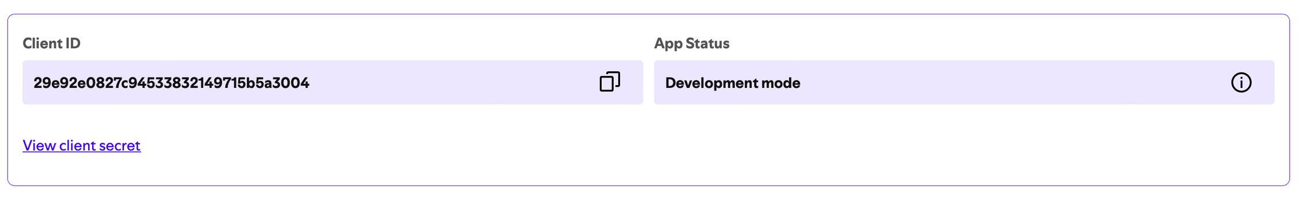
SPOTIPY ON SPOTIFY
PAGE 04
STEP 1 : Getting Spotify’s Credentials
Signup to https://developer.spotify.com
Request Client ID and Client Secret
Wait for approval

Slide 5

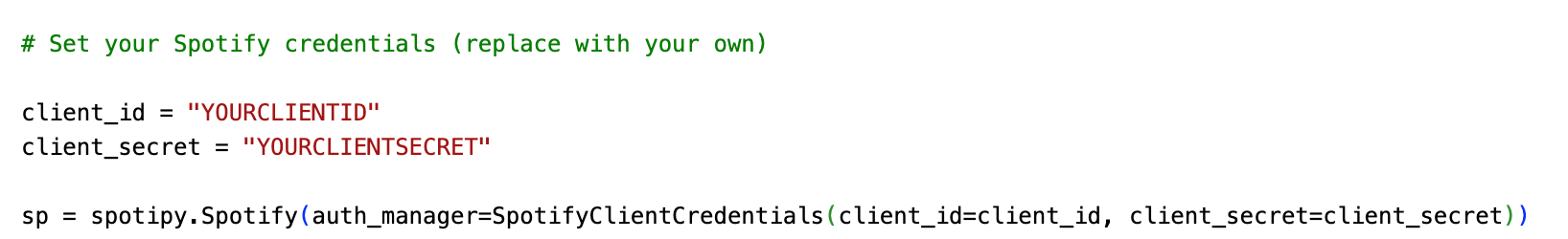
SPOTIPY ON SPOTIFY
PAGE 05
STEP 2 : Authenticate with Spotify
Notes:
“authenticate with Spotify API,” it means verifying your identity so Spotify knows who is trying to access their data.
3. Connecting to Spotify: With the credentials, Spotipy (the Python library you’re using) tells Spotify who you are, and if approved, Spotify lets you access the data you requested.

Slide 6
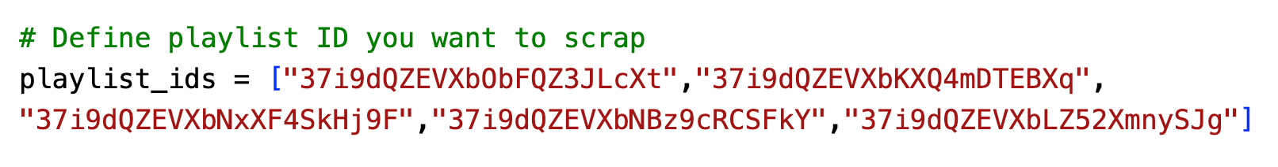
SPOTIPY ON SPOTIFY
PAGE 06
STEP 3 : Define Target Playlists
Get the Playlist Link
Top 50 Indonesia : https://open.spotify.com/playlist/37i9dQZEVXbObFQZ3JLcXt?si=1cc77672eba846ec
Select the Playlist ID
Notes:
“authenticate with Spotify API,” it means verifying your identity so Spotify knows who is trying to access their data.
3. Connecting to Spotify: With the credentials, Spotipy (the Python library you’re using) tells Spotify who you are, and if approved, Spotify lets you access the data you requested.

Slide 7
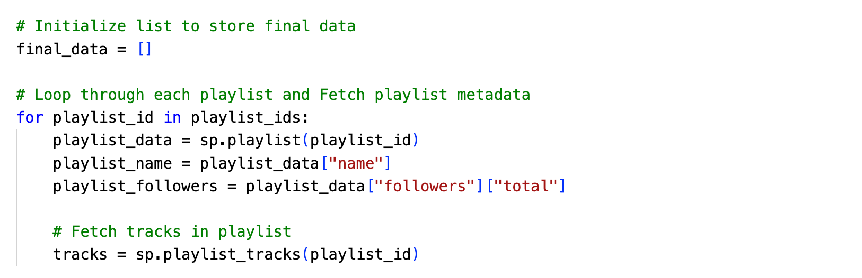
SPOTIPY ON SPOTIFY
PAGE 07
STEP 4 : Loop Through Each Playlist to Collect Metadata
Notes:
“authenticate with Spotify API,” it means verifying your identity so Spotify knows who is trying to access their data.
3. Connecting to Spotify: With the credentials, Spotipy (the Python library you’re using) tells Spotify who you are, and if approved, Spotify lets you access the data you requested.

Slide 8
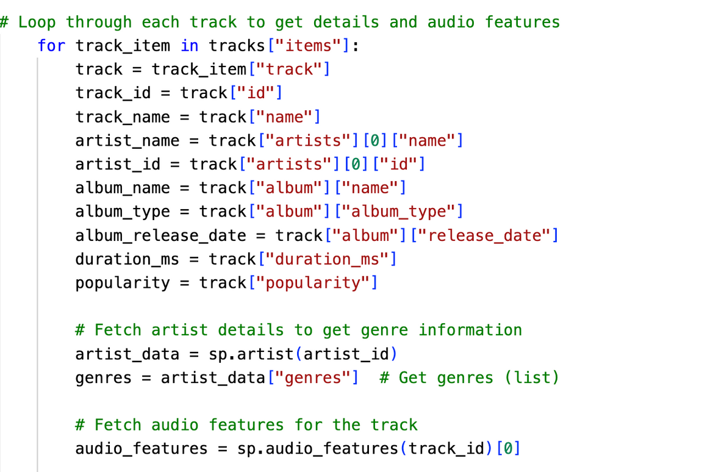
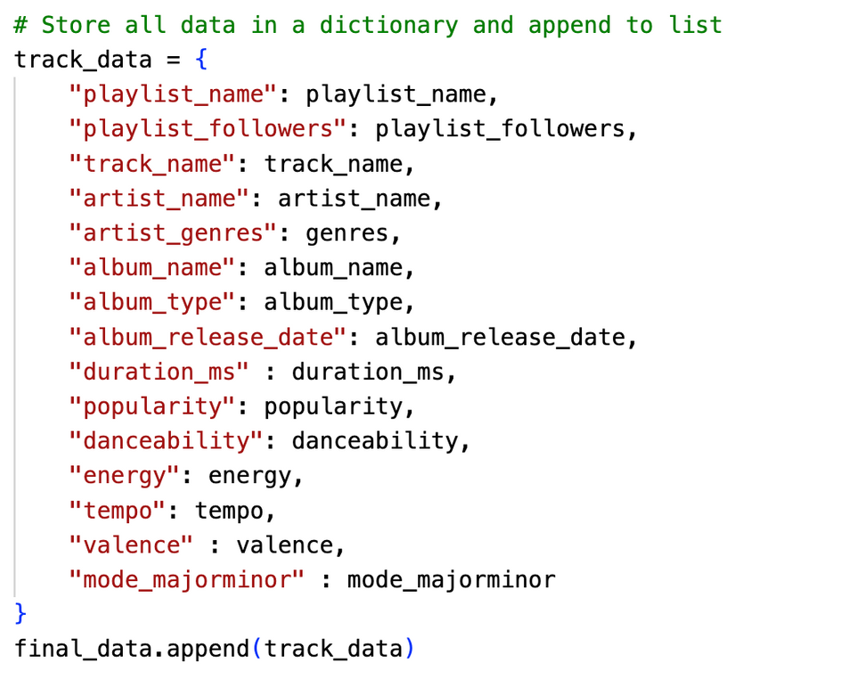
SPOTIPY ON SPOTIFY
PAGE 08
STEP 5 : Loop Through Each Track to Collect Audio Features
Notes:
“authenticate with Spotify API,” it means verifying your identity so Spotify knows who is trying to access their data.
3. Connecting to Spotify: With the credentials, Spotipy (the Python library you’re using) tells Spotify who you are, and if approved, Spotify lets you access the data you requested.

Slide 9
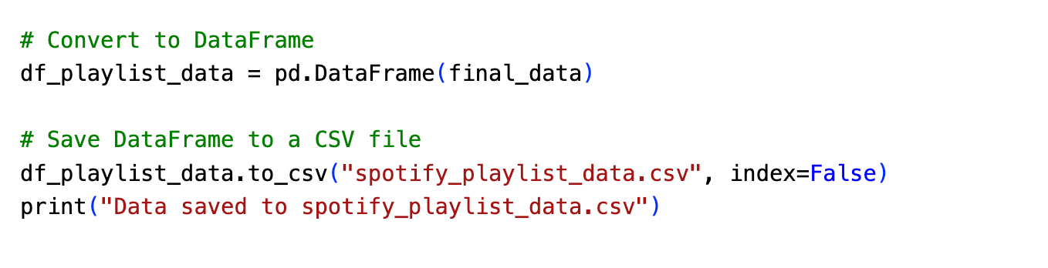
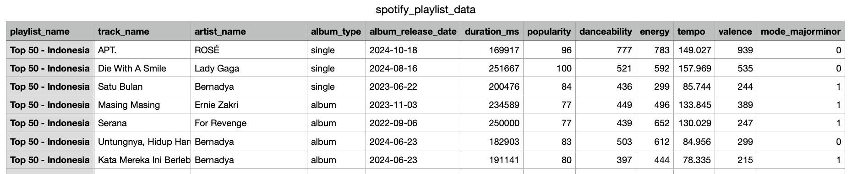
SPOTIPY ON SPOTIFY
PAGE 09
STEP 6 : Save and Export the Data
Notes:
“authenticate with Spotify API,” it means verifying your identity so Spotify knows who is trying to access their data.
3. Connecting to Spotify: With the credentials, Spotipy (the Python library you’re using) tells Spotify who you are, and if approved, Spotify lets you access the data you requested.

Slide 10
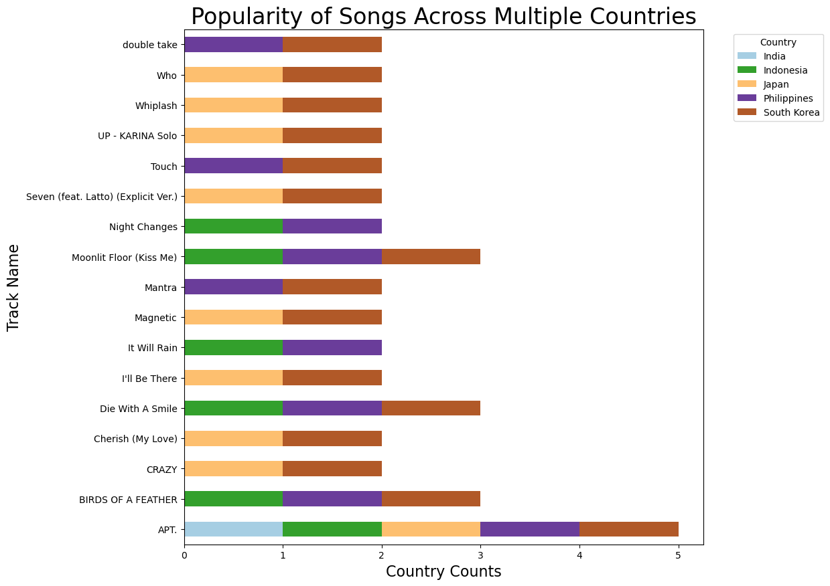
SPOTIPY ON SPOTIFY
PAGE 10
Cross-Country Popularity Analysis
There are 17 songs out of 250 songs that gained popularity in more than one country.
APT gain popularity across five countries.
Birds of a Feather, Die With a Smile, and Moonlit Floor indicate a potential similarity among Indonesia, Philippines, South Korea listeners.

Slide 11
SPOTIPY ON SPOTIFY
PAGE 11
Musical Moods
Analysis
Analyze musical moods for track popular in more than 2 countries
Analyze danceability, energy, tempo, valence, and musical keys.

Slide 12
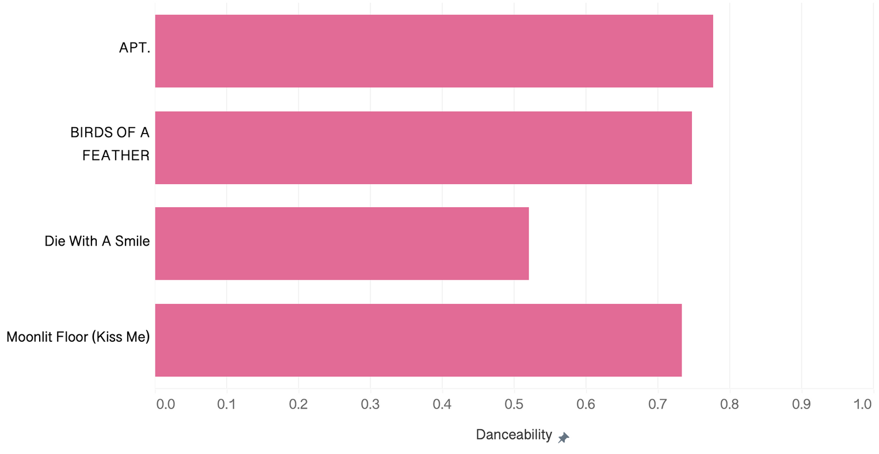

SPOTIPY ON SPOTIFY
PAGE 12
Danceability
0.0 is the least danceable
1.0 is the most danceable
Danceability describes how suitable a track is for dancing based on a combination of musical elements including tempo, rhythm stability, beat strength, and overall.

Slide 13
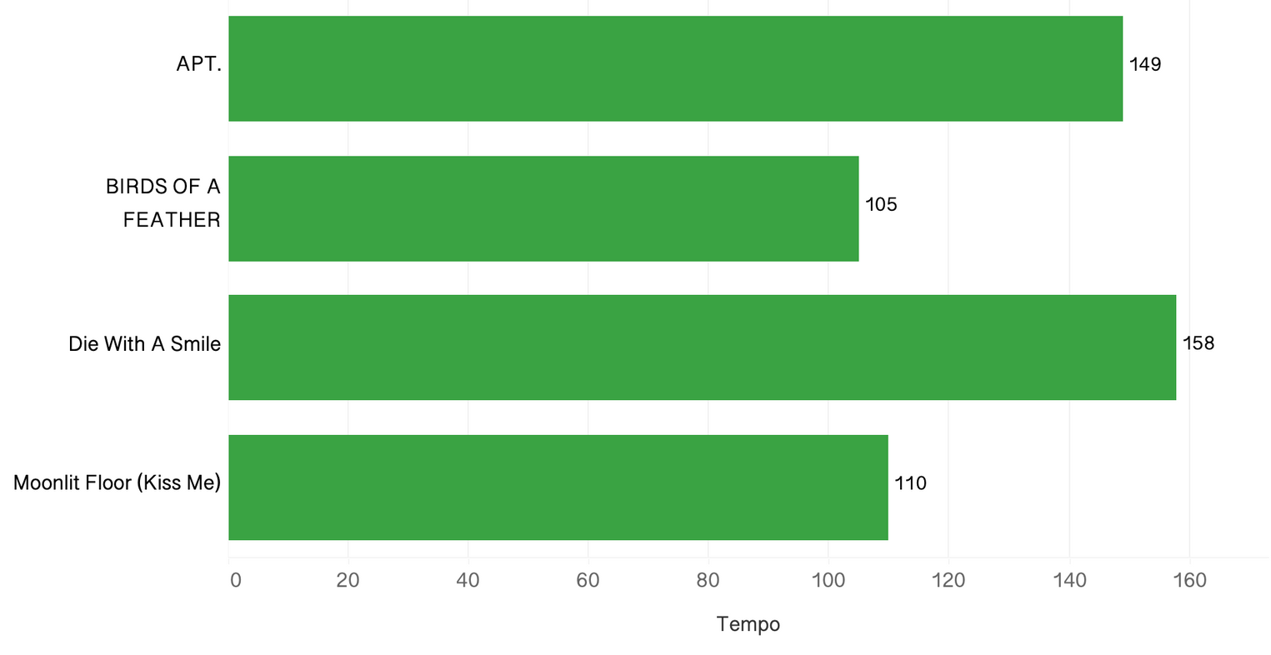
SPOTIPY ON SPOTIFY
PAGE 14
Tempo
The overall estimated tempo of a track in beats per minute (BPM). In musical terminology, tempo is the speed or pace of a given piece and derives directly from the average beat duration.

Slide 14
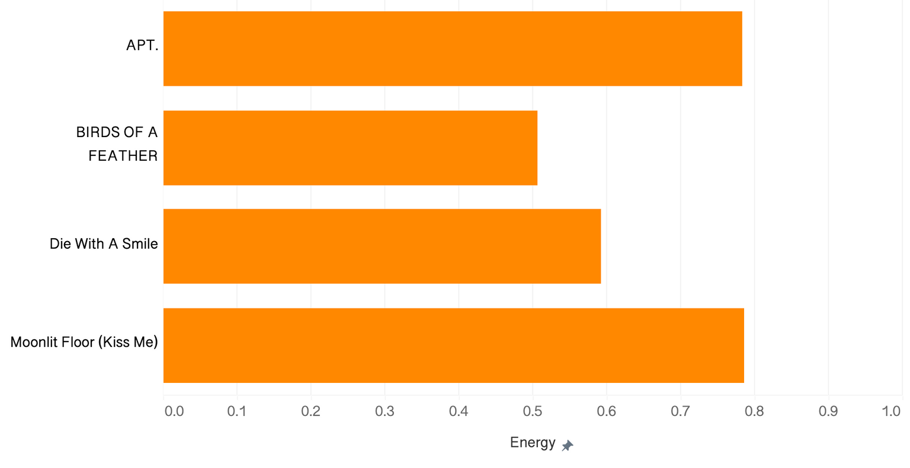
SPOTIPY ON SPOTIFY
PAGE 13
Energy
0.0 is the least energetic
1.0 is the most energetic
Typically, energetic tracks feel fast, loud, and noisy. For example, death metal has high energy, while a Bach prelude scores low on the scale.

Slide 15
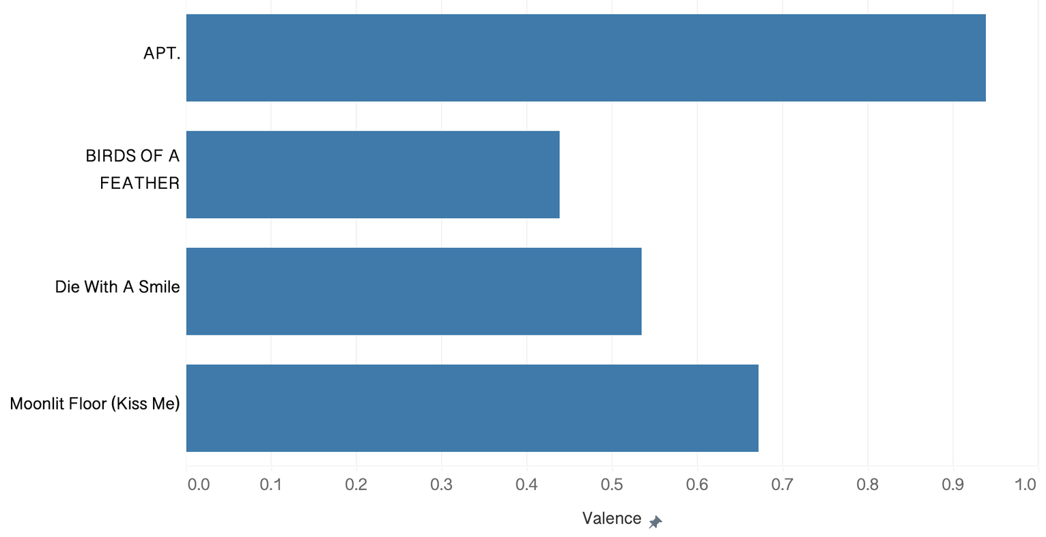
SPOTIPY ON SPOTIFY
PAGE 15
Valence
0.0 is low valence
1.0 is high valence
Tracks with high valence sound more positive (e.g. happy, cheerful, euphoric), while tracks with low valence sound more negative (e.g. sad, depressed, angry).

Slide 16
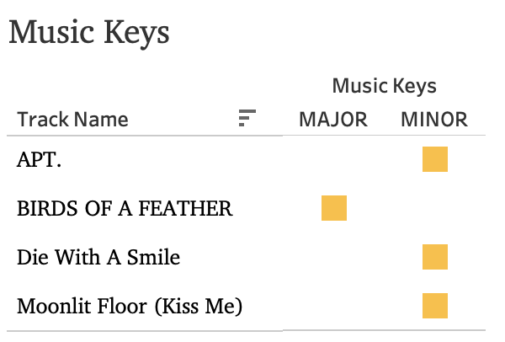
SPOTIPY ON SPOTIFY
PAGE 16
Musical Keys
Keys indicates the modality (major or minor) of a track, the type of scale from which its melodic content is derived.

Slide 17
SPOTIPY ON SPOTIFY
PAGE 17
Key Insights
Indonesia, Philippines, South Korea possess similarity in listener preferences
3 out of 3 songs popular in three countries are exclusive in these three countries.
Japan and South Korea having particularly aligned preferences
8 out of 16 songs popular exclusively in Japan and South Korea
South Korea shows a strong preference for cross country hits
15 out of 17 cross country tracks are popular in South Korea

Slide 18
SPOTIPY ON SPOTIFY
PAGE 18
Sounds Asia - Actionable Recommendation
Regional Shared Preferences
Cross-countries campaigns will help reach a larger audience and increase cost effectiveness.
Indonesia, Philippines, South Korea focus
Japan and South Korea focus
Mood Based Songs
Song with positive mood, happy, and energetic songs dominate the popular tracks across Asia.
Sounds Asia should support its artists by promoting tracks with similar audio features from their own artists in large, multi-country campaigns to reach wider audiences.

Slide 19
THANK YOU

